Slide 1

About Nmap
Process
Flowchart
Key Features
Nmap – Scanning tool

Slide 2
About Nmap :
Nmap is a robust, open-source tool that is frequently used for penetration testing, security audits and network discovery. It allows users to find running operating systems, firewalls, hosts and services on a network. Nmap uses a number of scanning methods, including FTP, TCP SYN (half-open), UDP and others, to give comprehensive information about network devices.
Standards

Slide 3
Process
Step 1: Enter IP Address or Hostname • Provide the target IP address or hostname that you want to scan.
Example: 192.168.1.1 Step 2: Enter Port Number • Specify the target port(s). Leave blank to scan all common ports.
Example: 22,80,443 or leave empty for default ports. Step 3: Select Scan Speed Select a scan timing template based on the requirements for stealth and network conditions:
• T0 – paranoid (Slowest speed, highly stealthy and quiet on the network) • T1 – sneaky (Very slow scan, reduces chances of being detected) • T2 – polite (Balanced speed, careful with network resources) • T3 – normal (Standard speed, provides reliable and balanced results) • T4 – aggressive (Faster scans, best for reliable and stable networks) • T5 – insane (Extremely fast, needs a strong and stable network)
Example: T3
Click on the model to interact

Slide 4
Step 4: Select Scan Type Choose the type of Nmap scan to perform, such as: • Operating System (OS) Detection
• Service/Version Detection • TCP SYN Scan • UDP Scan • Firewall Detection • Comprehensive Scan
Example: Operating System Step 5: Commence Scan • Click Scan to initiate the operation. Example: 192.168.1.1 Step 6: View Results • The output portion provides a clear display of the scan's results, which include open ports, service information, OS details, and probable vulnerabilities.
Let's look at an output example:
• nmap -T3 -O -p 22,80,443 192.168.1.1
Now lets breakdown the command-
• -T3: Normal speed
• -O: Operating System detection
• -p 22,80,443: Scanning ports 22 (SSH), 80 (HTTP) and 443 (HTTPS)
• 192.168.1.1: The IP address of the target host.
2. Relation between Earth, Sun, and Moon

Slide 5
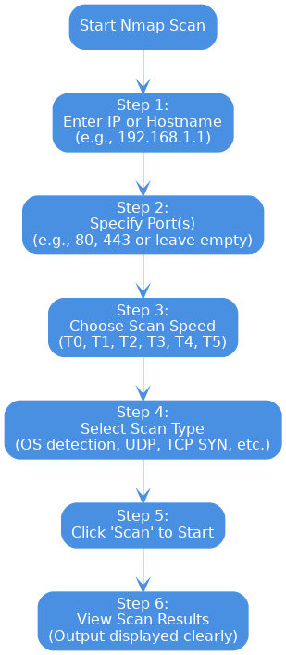
Flowchart

Slide 6
Key Features
• Host Discovery:
Checks which devices are active on a network.
• Port Scanning:
Finds open or closed ports on a device and identifies the services running on those ports.
• OS Detection:
Identifies the operating system (e.g., Windows, Linux) on a target device.
• Service Detection:
Discovers specific services and their version numbers running on target systems.
• Firewall and IDS Detection:
Detects if a firewall or intrusion detection system (IDS) is protecting a network or device.
• Scriptable Interaction (NSE):
Allows advanced scanning and customization through scripts for specific scanning tasks.

